Slide 1
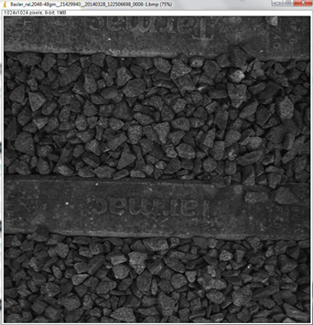
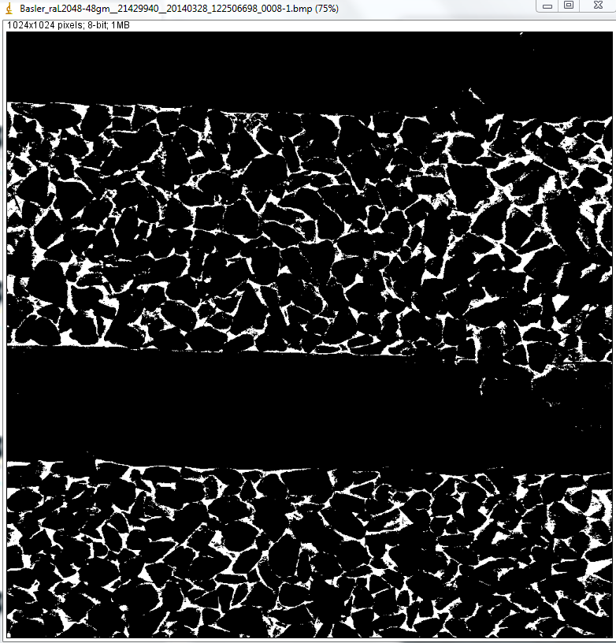
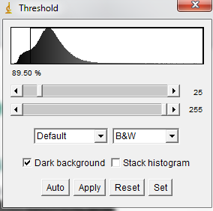
ImageJ
Image > Adjust > Threshold @ 90%
Notes:
3. Interpreting the data and deliverables:
Trackbed Layer Interpretation
Description of GPR derived trackbed metrics
Calibration of the BFI to PVC
Overview of the PDF plots
5.Presentation of Key Findings
Summary of metrics by route
Ranking the routes
correlation with TG
6.Planning tools
How other railroads use BFI
WOR
ZVAM viewer
Optram & 2D BBFI metrics

Slide 2
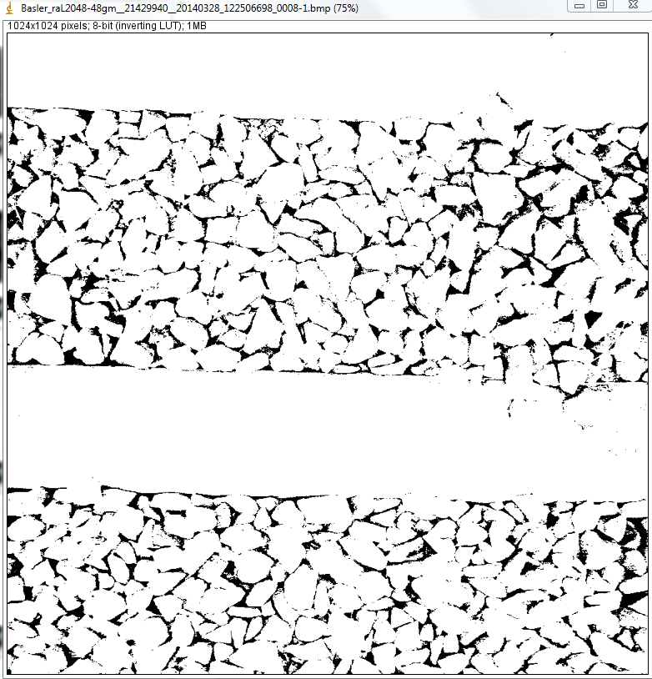
ImageJ
Process > Binary > Make Binary
Notes:
3. Interpreting the data and deliverables:
Trackbed Layer Interpretation
Description of GPR derived trackbed metrics
Calibration of the BFI to PVC
Overview of the PDF plots
5.Presentation of Key Findings
Summary of metrics by route
Ranking the routes
correlation with TG
6.Planning tools
How other railroads use BFI
WOR
ZVAM viewer
Optram & 2D BBFI metrics

Slide 3
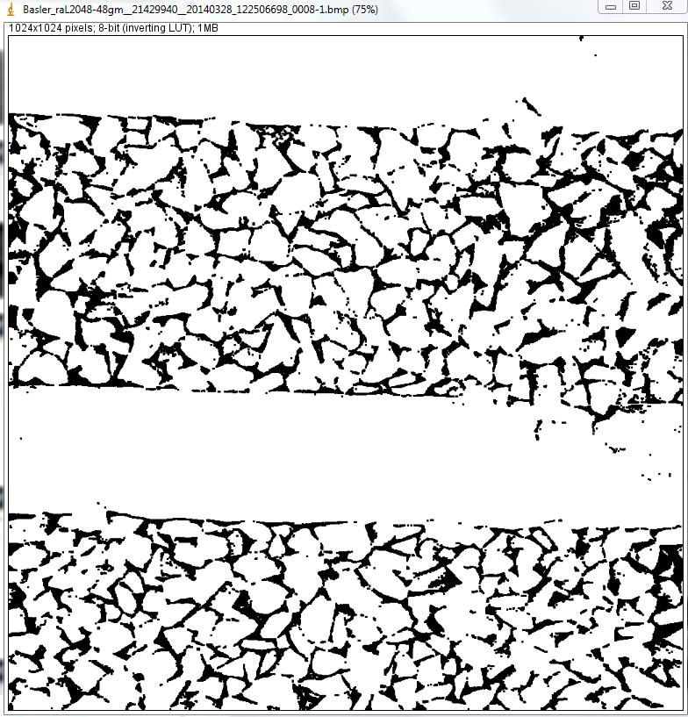
ImageJ
Process > Binary > Close & Dilate
Notes:
3. Interpreting the data and deliverables:
Trackbed Layer Interpretation
Description of GPR derived trackbed metrics
Calibration of the BFI to PVC
Overview of the PDF plots
5.Presentation of Key Findings
Summary of metrics by route
Ranking the routes
correlation with TG
6.Planning tools
How other railroads use BFI
WOR
ZVAM viewer
Optram & 2D BBFI metrics

Slide 4
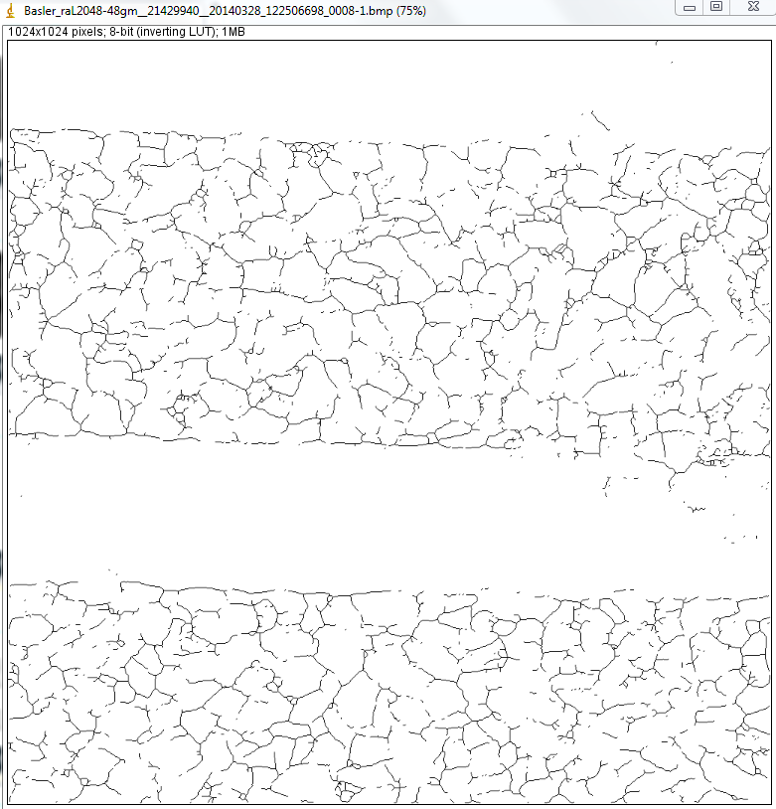
ImageJ
Process > Binary > Skeletonize
Notes:
3. Interpreting the data and deliverables:
Trackbed Layer Interpretation
Description of GPR derived trackbed metrics
Calibration of the BFI to PVC
Overview of the PDF plots
5.Presentation of Key Findings
Summary of metrics by route
Ranking the routes
correlation with TG
6.Planning tools
How other railroads use BFI
WOR
ZVAM viewer
Optram & 2D BBFI metrics

Slide 5
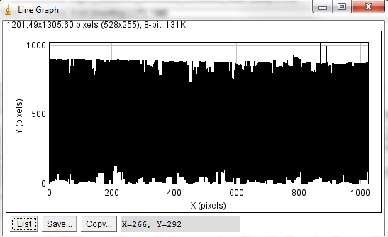
ImageJ
Process > Analyze > Tools > Line Graphs
Extracts coordinates of pixels in the skeleton image – total # pixels provides crude measure of image complexity / % small particles.
Total area absent (due to sleepers etc.) needs to be taken into account before analysis.
Notes:
3. Interpreting the data and deliverables:
Trackbed Layer Interpretation
Description of GPR derived trackbed metrics
Calibration of the BFI to PVC
Overview of the PDF plots
5.Presentation of Key Findings
Summary of metrics by route
Ranking the routes
correlation with TG
6.Planning tools
How other railroads use BFI
WOR
ZVAM viewer
Optram & 2D BBFI metrics

Slide 6
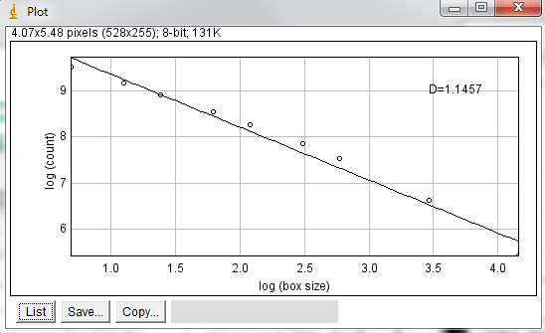
ImageJ
Process > Analyze > Tools > Fractal Box Size
Estimates the fractal dimension (D) of a binary image.
D can be used as a measure of pattern complexity
(cell shape, vascularization, textures, etc.) and is
specially relevant in cases in which Euclidean measures such as diameter or length are not good descriptors of complexity
Notes:
3. Interpreting the data and deliverables:
Trackbed Layer Interpretation
Description of GPR derived trackbed metrics
Calibration of the BFI to PVC
Overview of the PDF plots
5.Presentation of Key Findings
Summary of metrics by route
Ranking the routes
correlation with TG
6.Planning tools
How other railroads use BFI
WOR
ZVAM viewer
Optram & 2D BBFI metrics

Slide 7
Basler Camera Test Site Images
Notes:
3. Interpreting the data and deliverables:
Trackbed Layer Interpretation
Description of GPR derived trackbed metrics
Calibration of the BFI to PVC
Overview of the PDF plots
5.Presentation of Key Findings
Summary of metrics by route
Ranking the routes
correlation with TG
6.Planning tools
How other railroads use BFI
WOR
ZVAM viewer
Optram & 2D BBFI metrics

Slide 8
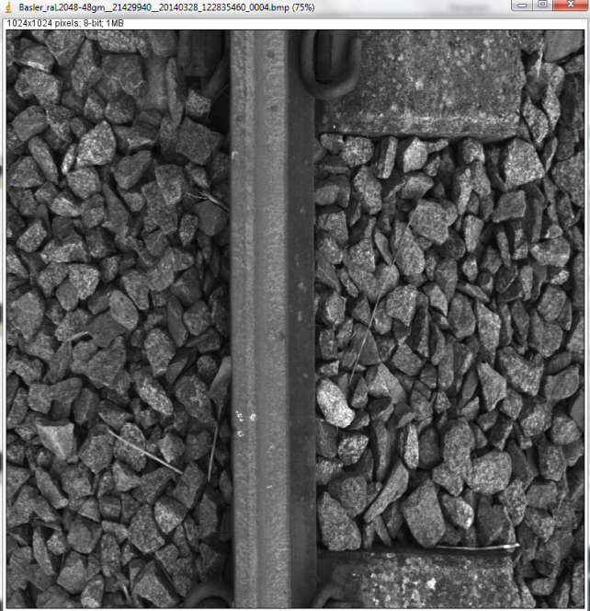
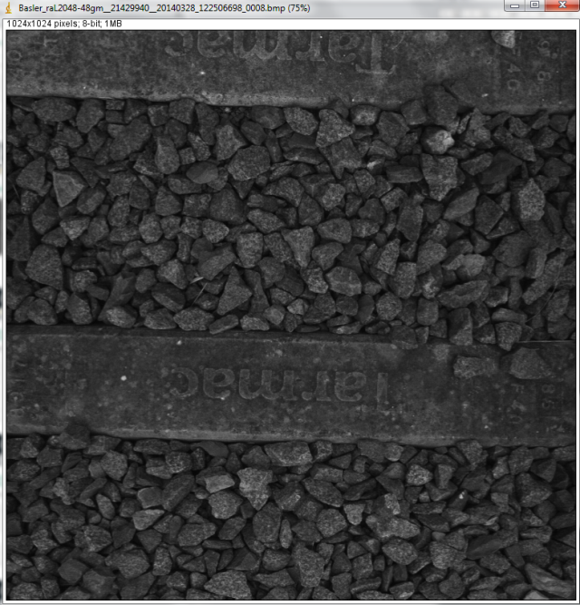
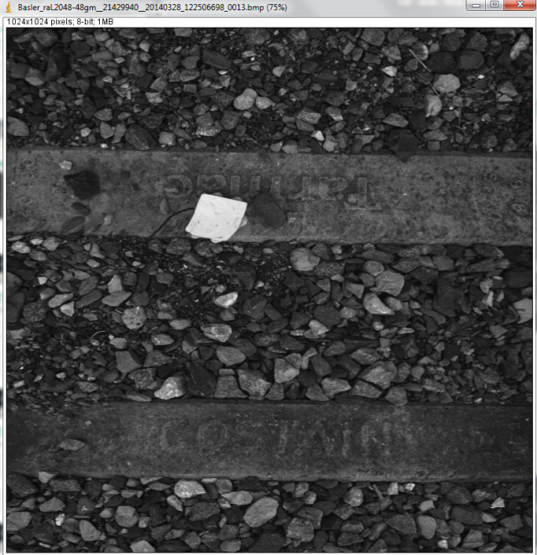
ImageJ – Test Images
_0004.bmp
_0008.bmp
_0013.bmp
Notes:
3. Interpreting the data and deliverables:
Trackbed Layer Interpretation
Description of GPR derived trackbed metrics
Calibration of the BFI to PVC
Overview of the PDF plots
5.Presentation of Key Findings
Summary of metrics by route
Ranking the routes
correlation with TG
6.Planning tools
How other railroads use BFI
WOR
ZVAM viewer
Optram & 2D BBFI metrics

Slide 9
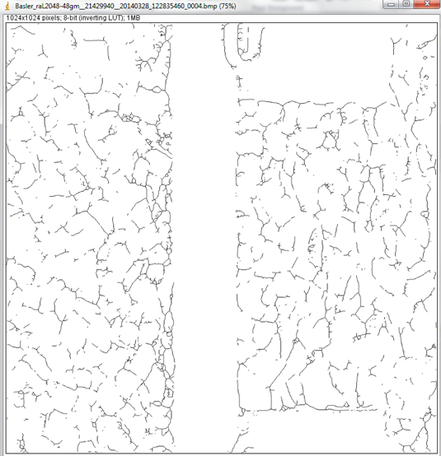
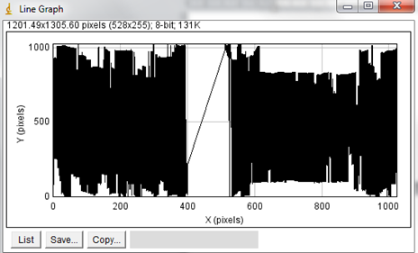
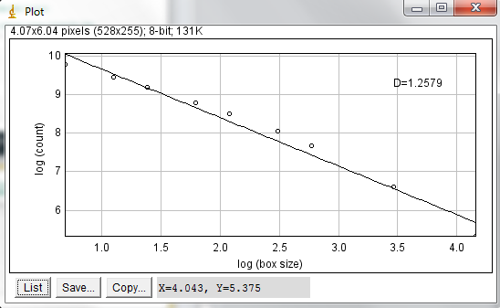
Clean Ballast: Basler_raL2048-48gm__21429940__20140328_122835460_0004.bmp
Pixel Count = 7210
D= 1.2579
Notes:
3. Interpreting the data and deliverables:
Trackbed Layer Interpretation
Description of GPR derived trackbed metrics
Calibration of the BFI to PVC
Overview of the PDF plots
5.Presentation of Key Findings
Summary of metrics by route
Ranking the routes
correlation with TG
6.Planning tools
How other railroads use BFI
WOR
ZVAM viewer
Optram & 2D BBFI metrics

Slide 10

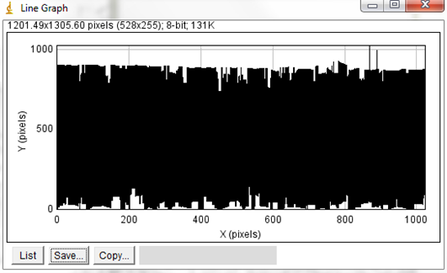

Clean Ballast: Basler_raL2048-48gm__21429940__20140328_122506698_0008.bmp
Pixel Count = 11083
D= 1.1457
Notes:
3. Interpreting the data and deliverables:
Trackbed Layer Interpretation
Description of GPR derived trackbed metrics
Calibration of the BFI to PVC
Overview of the PDF plots
5.Presentation of Key Findings
Summary of metrics by route
Ranking the routes
correlation with TG
6.Planning tools
How other railroads use BFI
WOR
ZVAM viewer
Optram & 2D BBFI metrics

Slide 11

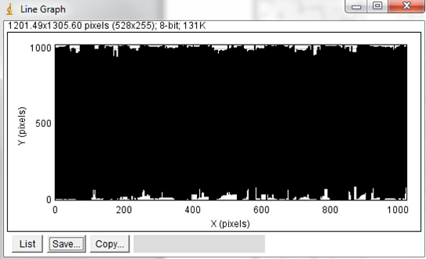
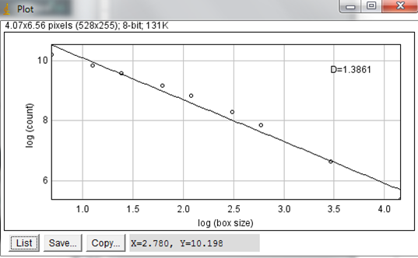
Dirty / Degraded Ballast: Basler_raL2048-48gm__21429940__20140328_122506698_0013.bmp
Pixel Count = 17412
D= 1.3861
Notes:
3. Interpreting the data and deliverables:
Trackbed Layer Interpretation
Description of GPR derived trackbed metrics
Calibration of the BFI to PVC
Overview of the PDF plots
5.Presentation of Key Findings
Summary of metrics by route
Ranking the routes
correlation with TG
6.Planning tools
How other railroads use BFI
WOR
ZVAM viewer
Optram & 2D BBFI metrics

Slide 12
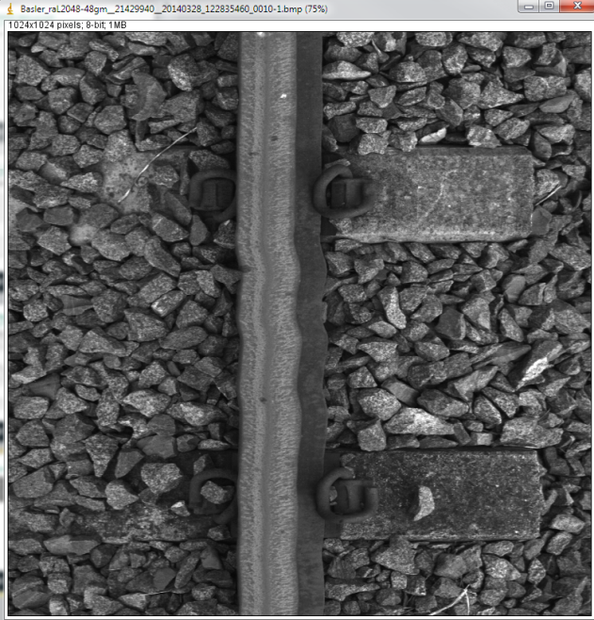
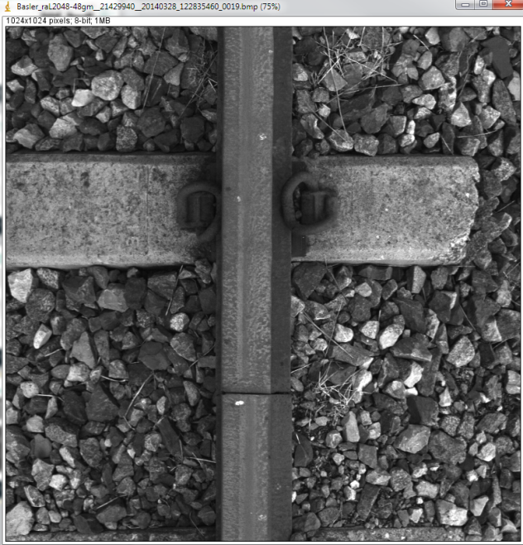
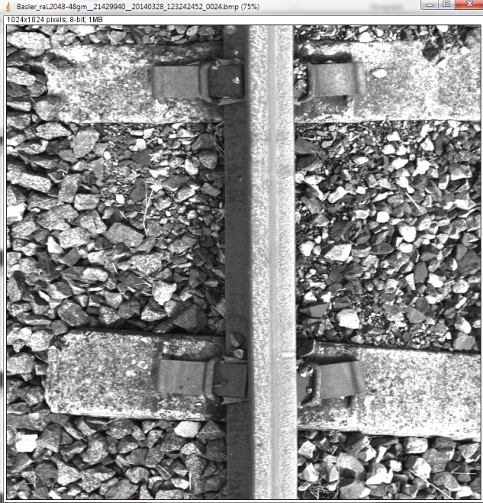
Particle Analysis - Count
_0010.bmp
_0019.bmp
_0024.bmp
Notes:
3. Interpreting the data and deliverables:
Trackbed Layer Interpretation
Description of GPR derived trackbed metrics
Calibration of the BFI to PVC
Overview of the PDF plots
5.Presentation of Key Findings
Summary of metrics by route
Ranking the routes
correlation with TG
6.Planning tools
How other railroads use BFI
WOR
ZVAM viewer
Optram & 2D BBFI metrics

Slide 13
RailVision Images
Notes:
3. Interpreting the data and deliverables:
Trackbed Layer Interpretation
Description of GPR derived trackbed metrics
Calibration of the BFI to PVC
Overview of the PDF plots
5.Presentation of Key Findings
Summary of metrics by route
Ranking the routes
correlation with TG
6.Planning tools
How other railroads use BFI
WOR
ZVAM viewer
Optram & 2D BBFI metrics

Slide 14
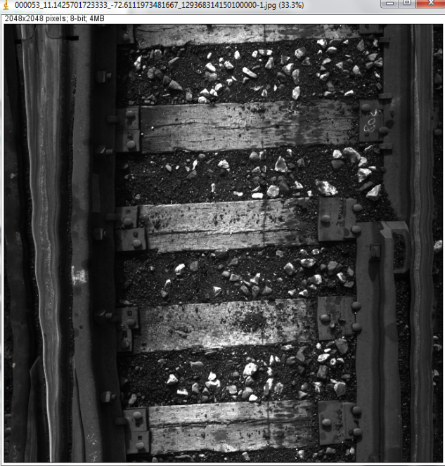
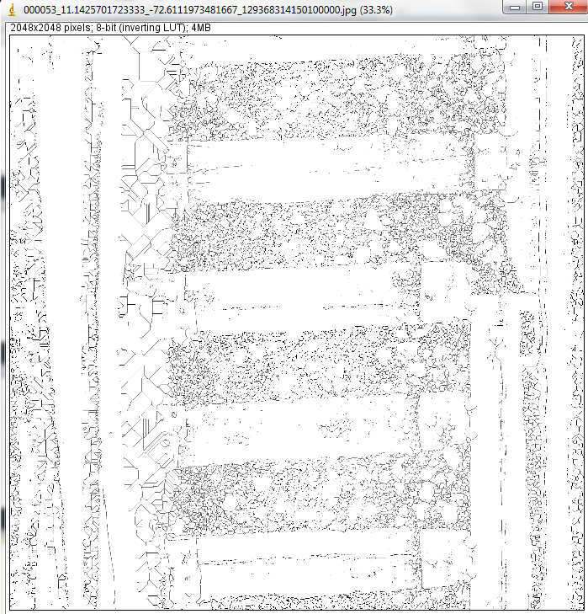
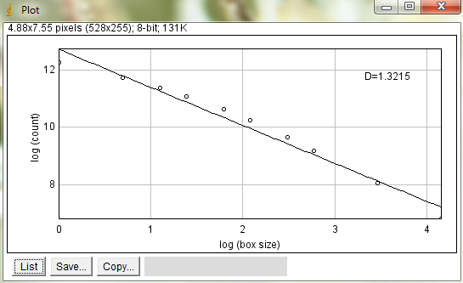
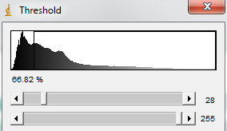

Coal Fouled Ballast: 000053_11.1425701723333_-72.6111973481667_129368314150100000.jpg
Analysis:
D= 1.3215
Particle Count = 7567
Notes:
3. Interpreting the data and deliverables:
Trackbed Layer Interpretation
Description of GPR derived trackbed metrics
Calibration of the BFI to PVC
Overview of the PDF plots
5.Presentation of Key Findings
Summary of metrics by route
Ranking the routes
correlation with TG
6.Planning tools
How other railroads use BFI
WOR
ZVAM viewer
Optram & 2D BBFI metrics

Slide 15
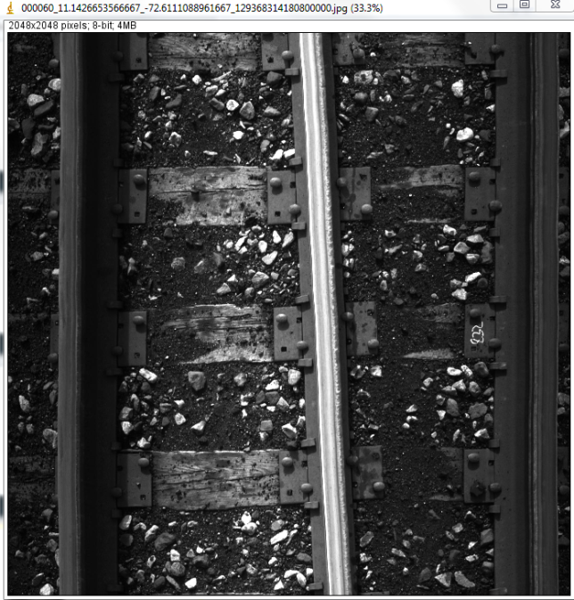
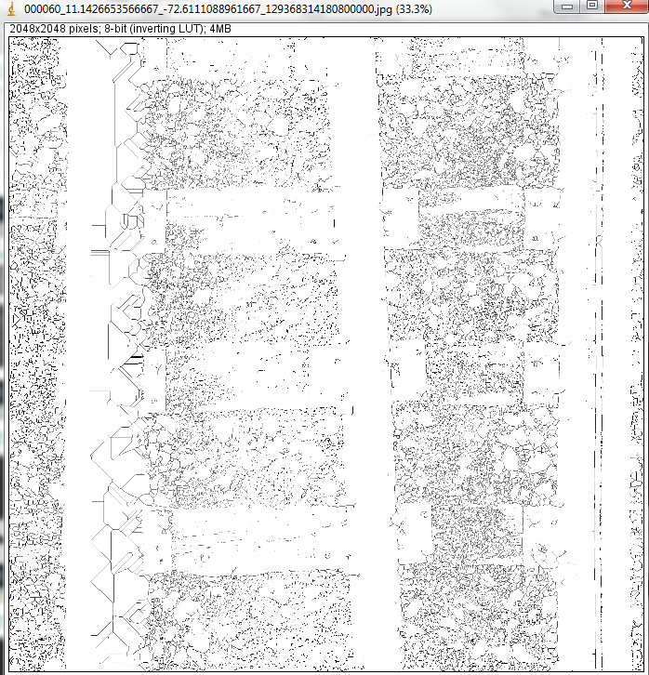
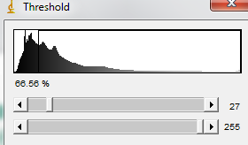
Coal Fouled Ballast: 000060_11.1426653566667_-72.6111088961667_129368314180800000.jpg
Analysis:
D= 1.3735
Particle Count = 9767
Threshold > Binary > Skeletonize
Threshold = 67%
Fractal box count box sizes:1,2,3,4,6,8,12,16,32,64
Notes:
3. Interpreting the data and deliverables:
Trackbed Layer Interpretation
Description of GPR derived trackbed metrics
Calibration of the BFI to PVC
Overview of the PDF plots
5.Presentation of Key Findings
Summary of metrics by route
Ranking the routes
correlation with TG
6.Planning tools
How other railroads use BFI
WOR
ZVAM viewer
Optram & 2D BBFI metrics

Slide 16
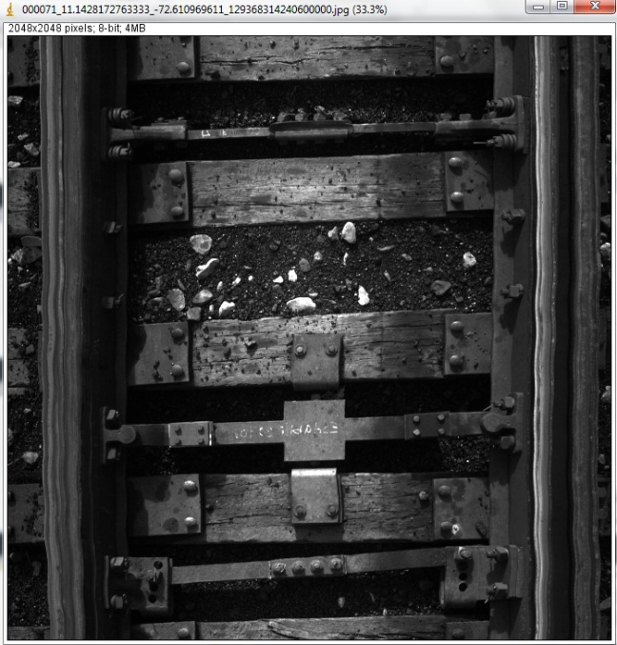

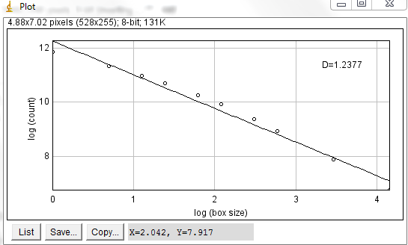
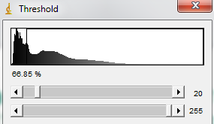
Coal Fouled Ballast: 000071_11.1428172763333_-72.610969611_129368314240600000.jpg
Analysis:
D= 1.2377
Particle Count = 4160
Threshold > Binary > Skeletonize
Threshold = 67%
Fractal box count box sizes:1,2,3,4,6,8,12,16,32,64
Notes:
3. Interpreting the data and deliverables:
Trackbed Layer Interpretation
Description of GPR derived trackbed metrics
Calibration of the BFI to PVC
Overview of the PDF plots
5.Presentation of Key Findings
Summary of metrics by route
Ranking the routes
correlation with TG
6.Planning tools
How other railroads use BFI
WOR
ZVAM viewer
Optram & 2D BBFI metrics

Slide 17
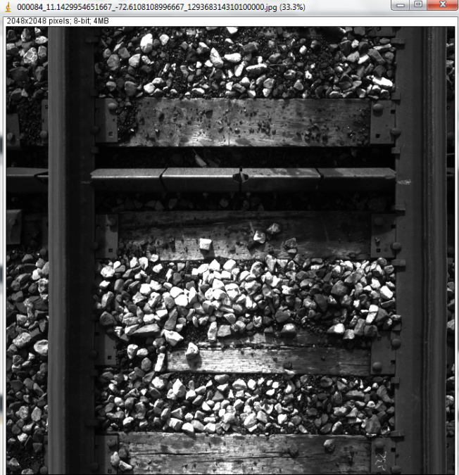
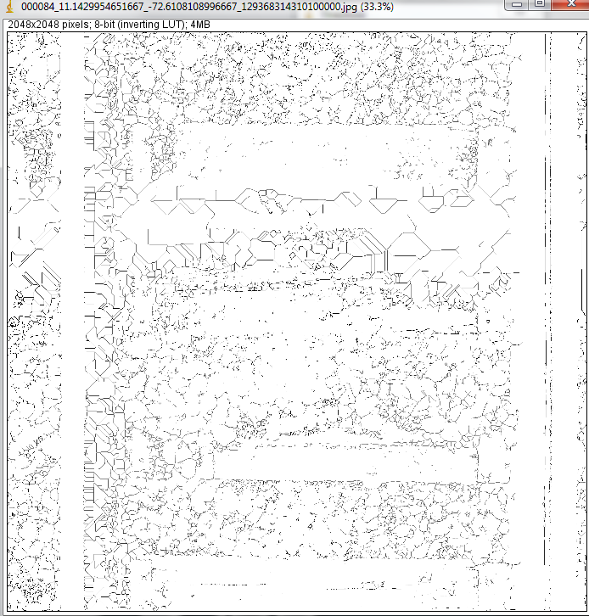
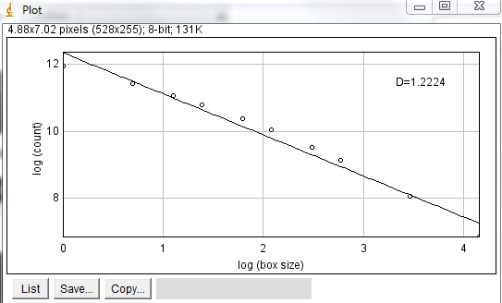
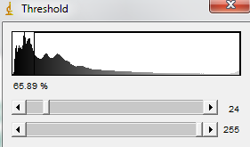
Coal Fouled Ballast (with clean top layer): 000084_11.1429954651667_-72.6108108996667_129368314310100000.jpg
Analysis:
D= 1.2224
Particle Count = 3676
Threshold > Binary > Skeletonize
Threshold = 66%
Fractal box count box sizes:1,2,3,4,6,8,12,16,32,64
Notes:
3. Interpreting the data and deliverables:
Trackbed Layer Interpretation
Description of GPR derived trackbed metrics
Calibration of the BFI to PVC
Overview of the PDF plots
5.Presentation of Key Findings
Summary of metrics by route
Ranking the routes
correlation with TG
6.Planning tools
How other railroads use BFI
WOR
ZVAM viewer
Optram & 2D BBFI metrics

Slide 18
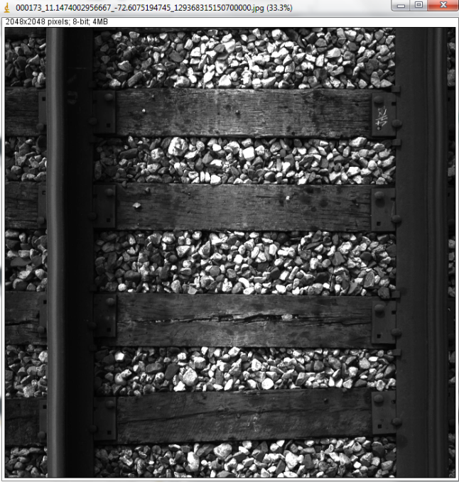

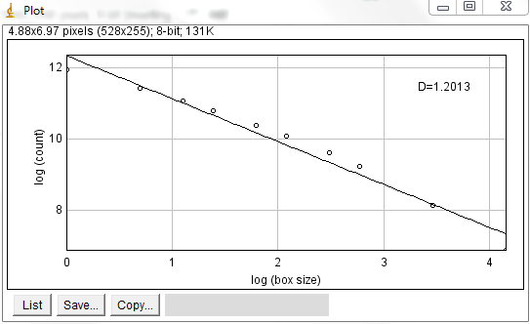
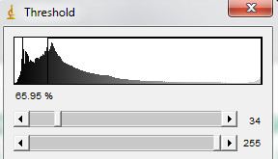
Clean Ballast: 000173_11.1474002956667_-72.6075194745_129368315150700000.jpg
Analysis:
D= 1.2013
Particle Count = 3676
Threshold > Binary > Skeletonize
Threshold = 66%
Fractal box count box sizes:1,2,3,4,6,8,12,16,32,64
Notes:
3. Interpreting the data and deliverables:
Trackbed Layer Interpretation
Description of GPR derived trackbed metrics
Calibration of the BFI to PVC
Overview of the PDF plots
5.Presentation of Key Findings
Summary of metrics by route
Ranking the routes
correlation with TG
6.Planning tools
How other railroads use BFI
WOR
ZVAM viewer
Optram & 2D BBFI metrics

Slide 19
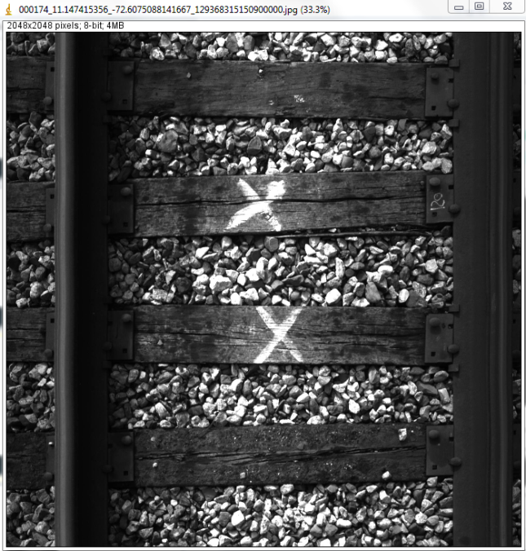


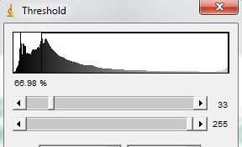
Clean Ballast: 000174_11.147415356_-72.6075088141667_129368315150900000.jpg
Analysis:
D= 1.2039
Particle Count = 4475
Threshold > Binary > Skeletonize
Threshold = 67%
Fractal box count box sizes:1,2,3,4,6,8,12,16,32,64
Notes:
3. Interpreting the data and deliverables:
Trackbed Layer Interpretation
Description of GPR derived trackbed metrics
Calibration of the BFI to PVC
Overview of the PDF plots
5.Presentation of Key Findings
Summary of metrics by route
Ranking the routes
correlation with TG
6.Planning tools
How other railroads use BFI
WOR
ZVAM viewer
Optram & 2D BBFI metrics

Slide 20
Effect of Dilation
Notes:
3. Interpreting the data and deliverables:
Trackbed Layer Interpretation
Description of GPR derived trackbed metrics
Calibration of the BFI to PVC
Overview of the PDF plots
5.Presentation of Key Findings
Summary of metrics by route
Ranking the routes
correlation with TG
6.Planning tools
How other railroads use BFI
WOR
ZVAM viewer
Optram & 2D BBFI metrics

Slide 21

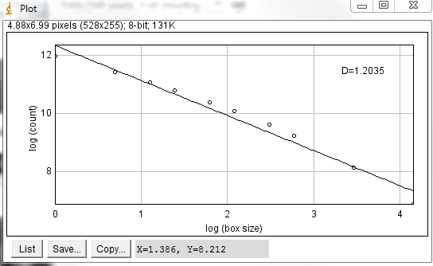
Clean Ballast: 000173_11.1474002956667_-72.6075194745_129368315150700000.jpg
Analysis:
D= 1.2035
Particle Count = 970
Threshold > Binary > Skeletonize > Dilate > Dilate
Threshold = 66%
Fractal box count box sizes:1,2,3,4,6,8,12,16,32,64
Notes:
3. Interpreting the data and deliverables:
Trackbed Layer Interpretation
Description of GPR derived trackbed metrics
Calibration of the BFI to PVC
Overview of the PDF plots
5.Presentation of Key Findings
Summary of metrics by route
Ranking the routes
correlation with TG
6.Planning tools
How other railroads use BFI
WOR
ZVAM viewer
Optram & 2D BBFI metrics

Slide 22
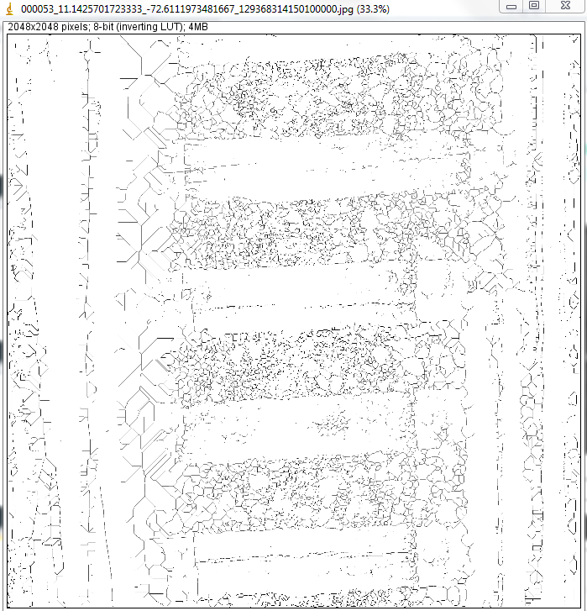

Coal Fouled Ballast: 000053_11.1425701723333_-72.6111973481667_129368314150100000.jpg
Analysis:
D= 1.2351
Particle Count = 331
Threshold > Binary > Skeletonize > Dilate > Dilate
Threshold = 67%
Fractal box count box sizes:1,2,3,4,6,8,12,16,32,64
Notes:
3. Interpreting the data and deliverables:
Trackbed Layer Interpretation
Description of GPR derived trackbed metrics
Calibration of the BFI to PVC
Overview of the PDF plots
5.Presentation of Key Findings
Summary of metrics by route
Ranking the routes
correlation with TG
6.Planning tools
How other railroads use BFI
WOR
ZVAM viewer
Optram & 2D BBFI metrics

Slide 23
Modified Thresholds
Notes:
3. Interpreting the data and deliverables:
Trackbed Layer Interpretation
Description of GPR derived trackbed metrics
Calibration of the BFI to PVC
Overview of the PDF plots
5.Presentation of Key Findings
Summary of metrics by route
Ranking the routes
correlation with TG
6.Planning tools
How other railroads use BFI
WOR
ZVAM viewer
Optram & 2D BBFI metrics

Slide 24
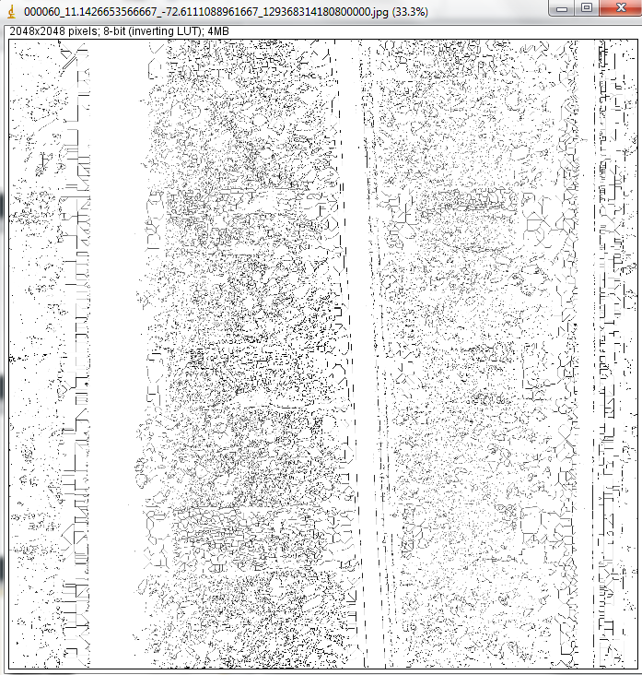
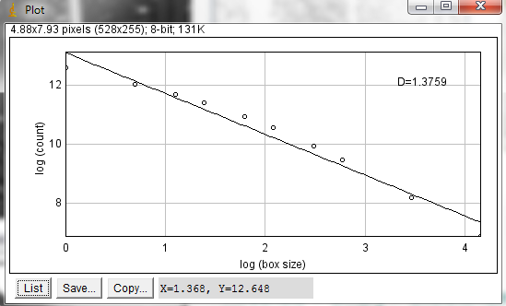
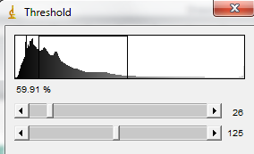
Coal Fouled Ballast: 000060_11.1426653566667_-72.6111088961667_129368314180800000.jpg
Analysis:
D= 1.3759
Particle Count = 10881
Threshold > Binary > Skeletonize
Threshold = 60% (26, 125)
Fractal box count box sizes:1,2,3,4,6,8,12,16,32,64
Notes:
3. Interpreting the data and deliverables:
Trackbed Layer Interpretation
Description of GPR derived trackbed metrics
Calibration of the BFI to PVC
Overview of the PDF plots
5.Presentation of Key Findings
Summary of metrics by route
Ranking the routes
correlation with TG
6.Planning tools
How other railroads use BFI
WOR
ZVAM viewer
Optram & 2D BBFI metrics

Slide 25
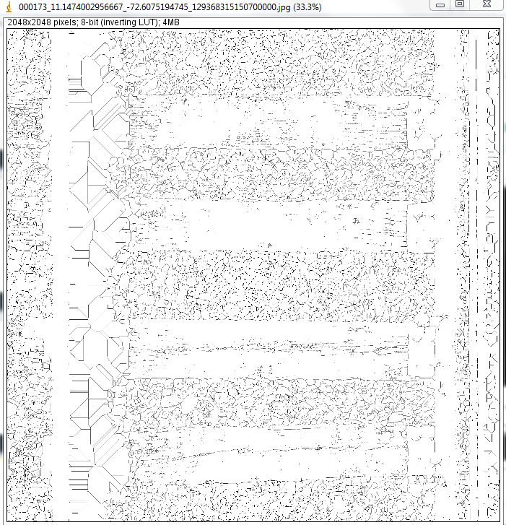
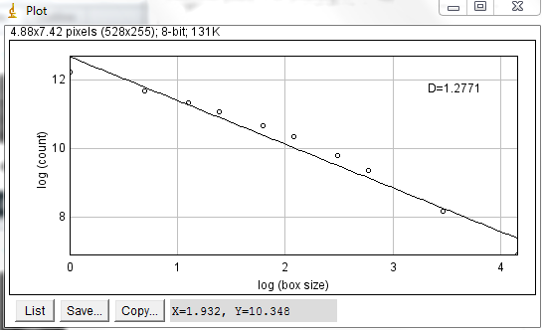
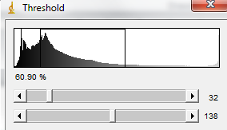
Clean Ballast: 000173_11.1474002956667_-72.6075194745_129368315150700000.jpg
Analysis:
D= 1.2771
Particle Count = 6221
Threshold > Binary > Skeletonize
Threshold = 60% (32, 138)
Fractal box count box sizes:1,2,3,4,6,8,12,16,32,64
Notes:
3. Interpreting the data and deliverables:
Trackbed Layer Interpretation
Description of GPR derived trackbed metrics
Calibration of the BFI to PVC
Overview of the PDF plots
5.Presentation of Key Findings
Summary of metrics by route
Ranking the routes
correlation with TG
6.Planning tools
How other railroads use BFI
WOR
ZVAM viewer
Optram & 2D BBFI metrics

Slide 26
RailVision Images:
Analysis indicates that image size relative to scale of inhomogeneity is important - higher resolution images are better.
‘Clean’ ballast images require dilation prior to skeletonization in order to sufficiently separate the particles for analysis.
Without dilation particle count analysis on clean ballast images gives high count. Fractal dimension result is similar. Dilation reduces count as particles are discretized.
However, dilation also reduces particle count for fouled ballast images. This is not seen on higher resolution images from Basler camera.
Thresholding also critical – well controlled lighting is going to be critical to ensure consistency between images.
Notes:
3. Interpreting the data and deliverables:
Trackbed Layer Interpretation
Description of GPR derived trackbed metrics
Calibration of the BFI to PVC
Overview of the PDF plots
5.Presentation of Key Findings
Summary of metrics by route
Ranking the routes
correlation with TG
6.Planning tools
How other railroads use BFI
WOR
ZVAM viewer
Optram & 2D BBFI metrics

